Slide 1
DIGITAL PORTFOLIO:
NAME : MOHAMMAD ASLAM
DEPARTMENT: BCA
NM ID :422D870BAE2915C91DB41B3BC4D19886
COLLEGE: GOVERNMENT ARTS AND SCIENCE COLLEGE GUDALUR

Slide 2

PROJECT TITLE
“Design and Development of a Personal Digital Portfolio using
HTML, CSS, and JAVASCRIPT”

Slide 3

AGENDA
PROBLEM STATEMENT PROJECT OVERVIEW
TOOLS AND TECHNOLOGIES PORTFOLIO DESIGN AND LAYOUT FEATURES AND FUNCTIONALITY RESULT AND SCREENSHOTS CONCLUSION

Slide 4

PROJECT TITLE
In the modern professional and academic world, resumes and traditional portfolios are no longer sufficient to highlight an individual’s true potential. Employers, recruiters, and clients now expect a digital presence where they can quickly evaluate a candidate’s skills, projects, and achievements. A Digital Portfolio addresses this issue by creating an online platform that is interactive, visually appealing, and accessible globally. It allows users to present themselves effectively while leaving a strong professional impression.

Slide 5

PROJECT OVERVIEW:
The Digital Portfolio project aims to design and develop a personalized, web-based portfolio that showcases an individual’s educational background, technical skills, projects, certifications, and achievements. The portfolio will be simple, attractive, and responsive across devices. The main objective is to provide an online professional identity for users that can be shared with potential employers, institutions, or clients.

Slide 6

WHO ARE THE END USER:
Students – to present academic projects, skills, and achievements for internships or higher studies. Job Seekers/Professionals – to highlight resumes, work experience, and project contributions. Freelancers – to showcase previous work and attract new clients. Researchers/Academicians – to display publications, research projects, and academic achievements. Employers/Recruiters – who use the portfolio to assess candidates quickly and efficiently.

Slide 7

TOOLS AND TECHNOLOGY:
HTML (HyperText Markup Language) Used to create the structure of the portfolio. Helps organize the content into sections like About Me, Projects, Skills, and Contact. CSS (Cascading Style Sheets) Used for styling and design of the portfolio. Controls layout, colors, fonts, animations, and responsiveness to make the portfolio visually appealing and user-friendly. JavaScript Provides interactivity and functionality to the portfolio. Enables features like navigation menus, interactive forms, animations, and smooth scrolling.

Slide 8

PORTFOLIO DESIGNS AND LAYOUT:
The portfolio will be structured into the following sections:
Home Page/Banner – A professional introduction with name, role, and background.
About Me – Personal profile, education details, and career goals. Skills – Technical and soft skills represented with icons or progress visuals.
Projects – Detailed descriptions with images, GitHub links, and live demos.
Certifications & Achievements – Academic and professional recognitions. Contact – Contact form, email, phone, and links to LinkedIn/GitHub.

Slide 9

FEATURES AND FUNCTIONALITY
Responsive design that adapts to all screen sizes. Smooth navigation with interactive animations and effects. Project showcase with descriptions, screenshots, and external links. Option to download resume in PDF format. Social media integration for LinkedIn, GitHub, or personal blogs. Contact form with email integration for direct communication. Optional visitor analytics to track portfolio reach and engagement.

Slide 10
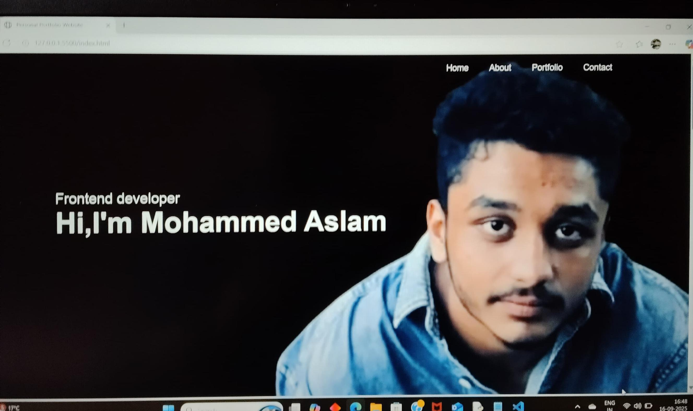
RESULTS AND SCREEN SHOTS

Slide 11
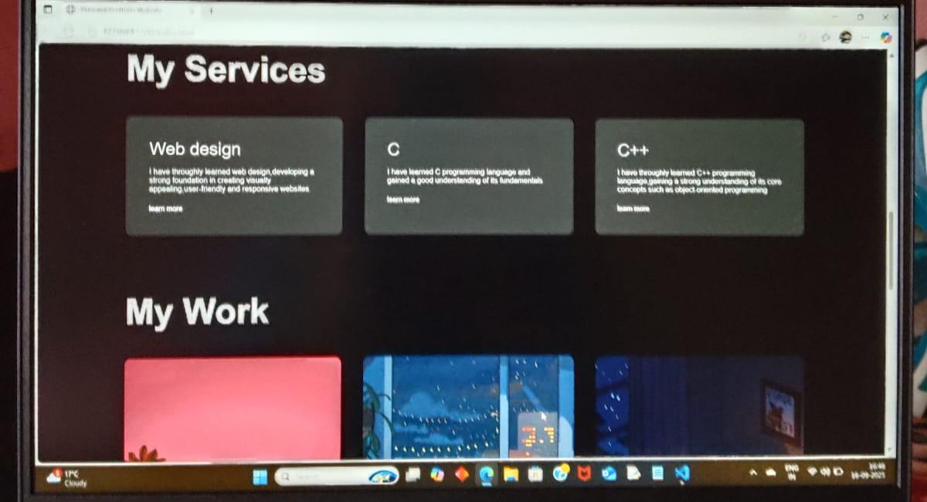
RESULT AND SCREENSHOTS

Slide 12
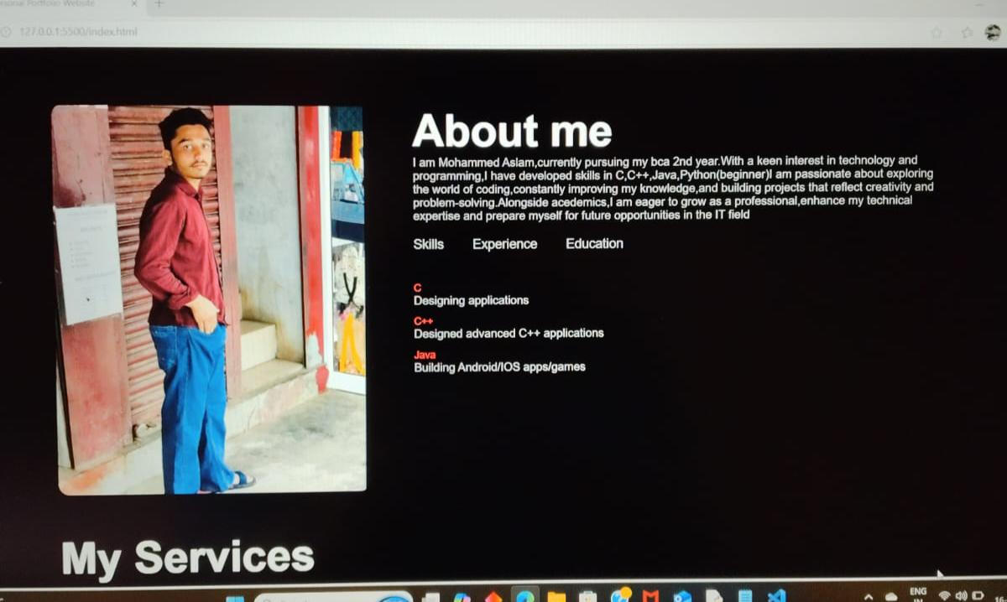
RESULTS AND SCREENSHOTS

Slide 13

CONCLUSIONS
The Digital Portfolio is an effective solution for students, professionals, and freelancers to build their digital presence. By integrating modern tools, responsive design, and interactive features, the portfolio not only enhances personal branding but also increases opportunities in academics, jobs, and freelance markets.

